Slide 1
Topic: Angles of Depression and Elevation
EQ: What is the difference between the two and how can they be solved using trigonometry?

Slide 2




Starter
2cm
a
11cm
$${27}^{o}$$
$$θ$$
14cm
$$x$$
$${79}^{o}$$
31cm

Slide 3
Topic: Angles of Elevation and Depression EQ: What is the difference between them and how can they be solved with trigonometry?
Learning Objectives:
Able to find the length of a side using trigonometry
Able to find an angle using trigonometry
Able to apply this to worded problems including angles of elevation and
depression
Summary:

Slide 4
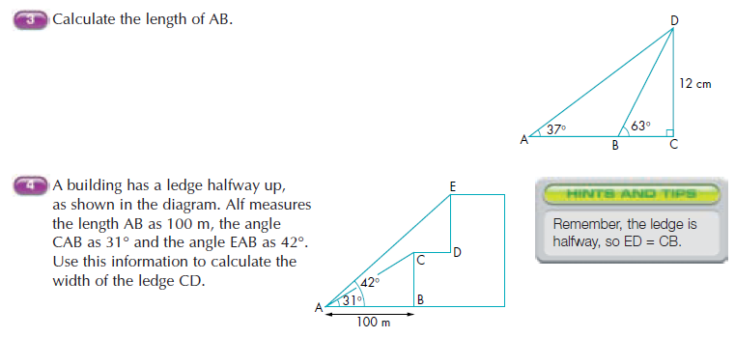

Slide 5
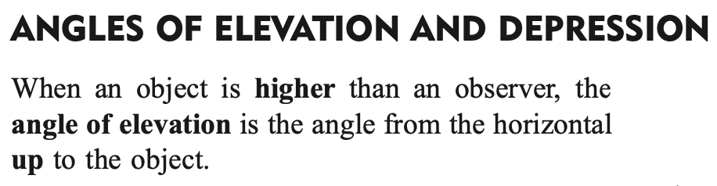
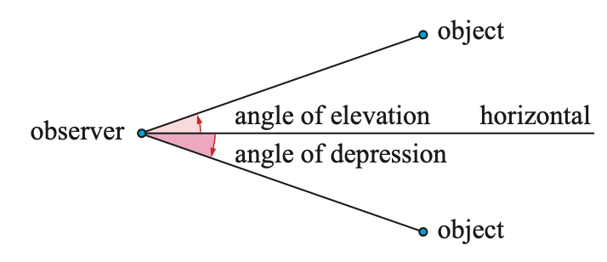
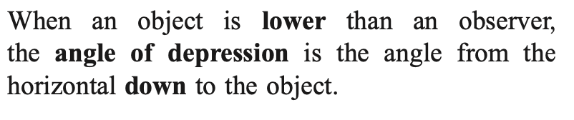
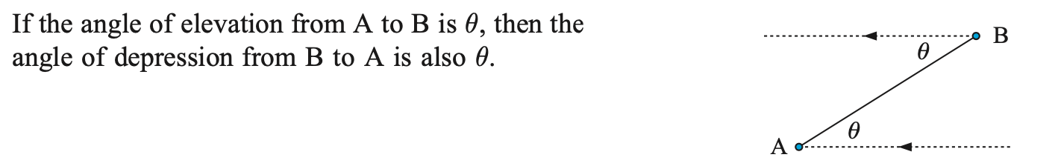
Topic: Angles of Elevation and Depression EQ: What is the difference between them and how can they be solved with trigonometry?

Slide 6
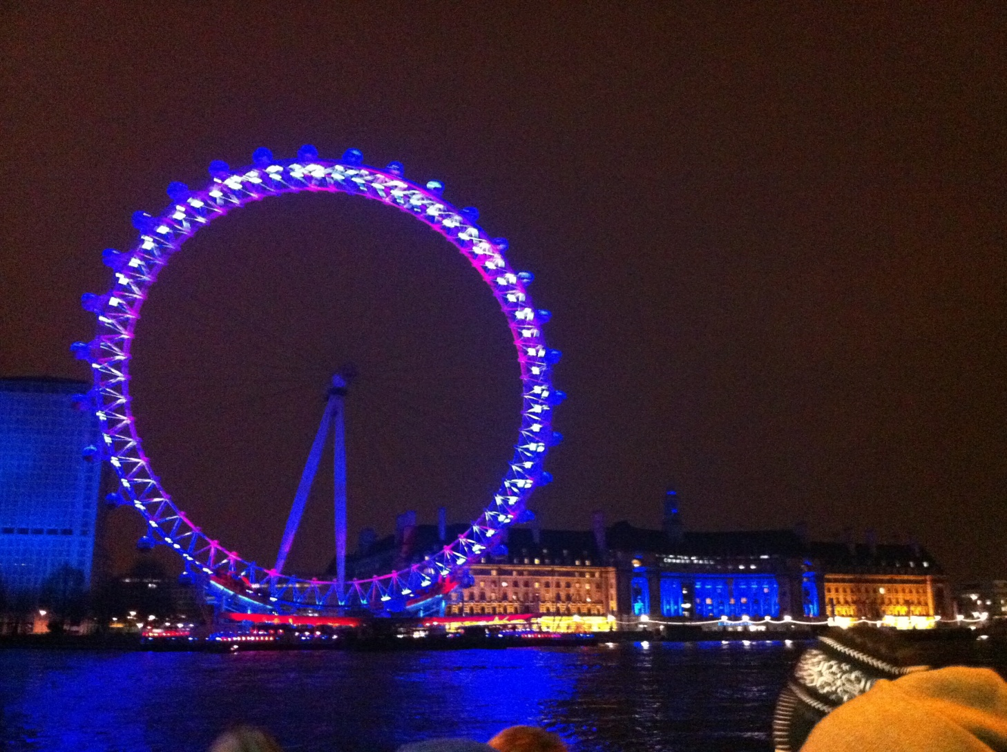
Topic: Angles of Elevation and Depression EQ: What is the difference between them and how can they be solved with trigonometry?
How can I work out the height of the London Eye?
Opposite
Adjacent
tanѲ =
tan50 =
h = 113.3tan50
h = 134.67m (2dp)
h
113.3
50º
113.3m

Slide 7
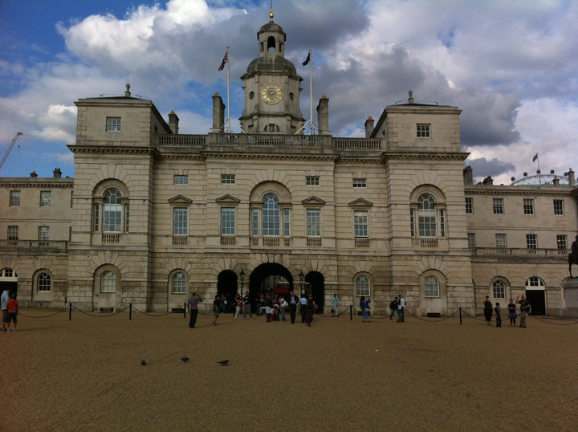
Topic: Angles of Elevation and Depression EQ: What is the difference between them and how can they be solved with trigonometry?
If I stand 140m from Horseguard’s Parade, the building is 60m tall, what is my angle of elevation?

Slide 8
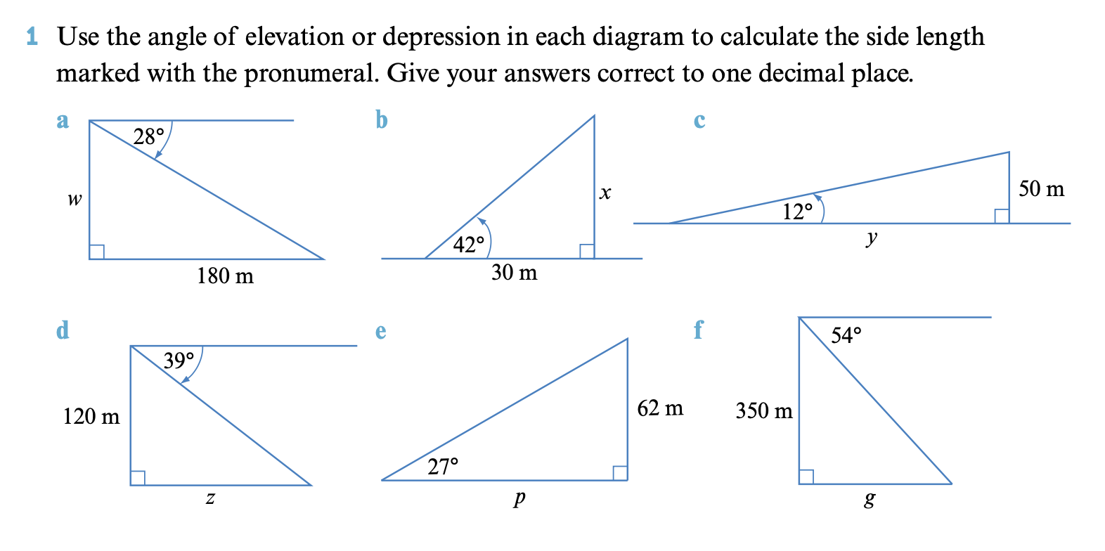
Practice

Slide 9
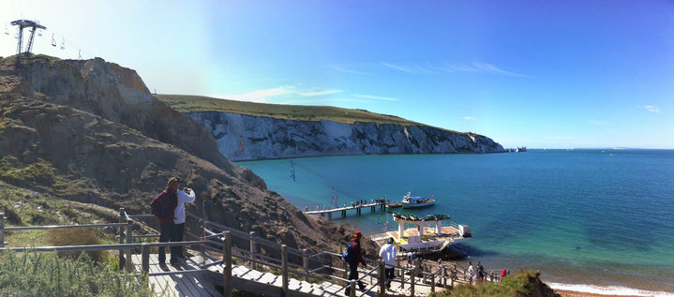


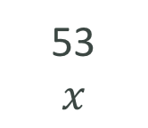
Topic: Angles of Elevation and Depression EQ: What is the difference between them and how can they be solved with trigonometry?
I want to work out how far away the beach is from where I’m standing. I know I’m currently 53m above sea level.
I need to know my angle of depression.
Opposite
Adjacent
tanѲ =
tan21 =
$x$ = $\frac{53}{tan21}$
$x$ = 138.1m (2dp)
53
$$x$$
$$x$$
21º
53m

Slide 10
Topic: Angles of Elevation and Depression EQ: What is the difference between them and how can they be solved with trigonometry?
Solve the following by drawing a diagram and applying trig rules:
EXAMPLE 1: A boat is at sea and sees the light of a lighthouse in the distance. The captain knows the lighthouse is 86m tall. Given his angle of elevation when looking at the light is 13º, how far away is the boat from the lighthouse?
EXAMPLE 2: While cleaning a hall, a cleaner spots a mouse on the floor 12m away. Given the woman is 1.6m tall, what is her angle of depression?

Slide 11
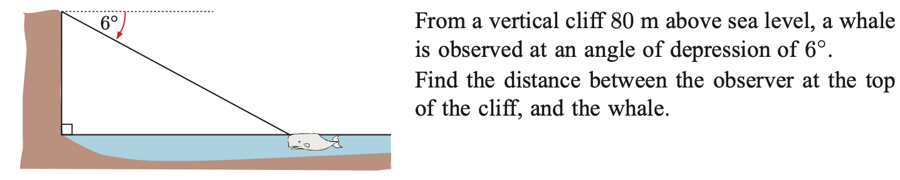
Extension

Slide 12
Topic: Angles of Elevation and Depression EQ: What is the difference between them and how can they be solved with trigonometry?
Complete your summary
Complete angles of Elevation and Depression worksheet
Summary:

